Slide 1

Introduction to Sudoku Solver Visualizer
Welcome to the Sudoku Solver Visualizer, a powerful tool that not only solves complex Sudoku puzzles, but also provides a captivating visual representation of the solving process. This application is designed to help both experienced and novice Sudoku enthusiasts deepen their understanding of the game's mechanics and strategies.

Slide 2
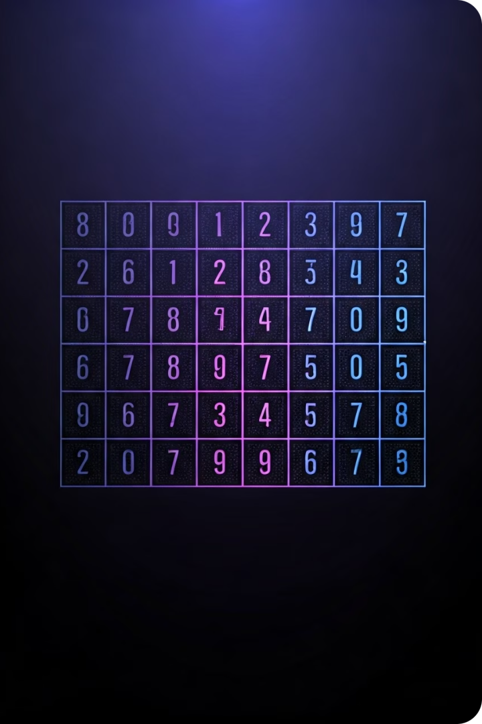
Sudoku Puzzle Basics
1
Objective
The objective of Sudoku is to fill a 9x9 grid with digits so that each column, each row, and each of the nine 3x3 subgrids that compose the grid contains all of the digits from 1 to 9.
2
Rules
Sudoku puzzles must be completed without repeating any numbers within each row, column, or 3x3 subgrid. The game starts with a partially filled grid, and the player must use logic and deduction to fill in the remaining cells.
3
Difficulty Levels
Sudoku puzzles come in varying difficulty levels, ranging from easy to extremely challenging. The more cells that are initially filled, the easier the puzzle, as there are fewer possibilities to consider.

Slide 3
Sudoku Solving Algorithms
Brute Force
Logical Reasoning
Constraint Propagation
The brute force algorithm systematically checks all possible combinations of numbers until a valid solution is found. While effective, this method can be computationally intensive for complex puzzles.
Logical reasoning algorithms rely on deductive logic and pattern recognition to identify the unique solution to a Sudoku puzzle. These algorithms are often more efficient and can provide valuable insights into the solving process.
Constraint propagation algorithms work by identifying and eliminating impossible candidates in each cell, gradually narrowing down the possibilities until a single valid solution is found.

Slide 4

Visualizing the Solving Process
Backtracking Visualization
Highlighting Candidates
For more complex puzzles, the visualizer will showcase the backtracking process, where the algorithm revisits previous steps to find an alternate solution.
The visualizer will highlight the possible values for each empty cell, allowing users to better understand the decision-making process.
1
2
3
Step-by-Step Solving
As the algorithm progresses, the visualizer will animate the filling of cells, providing a clear and engaging representation of the solving process.

Slide 5
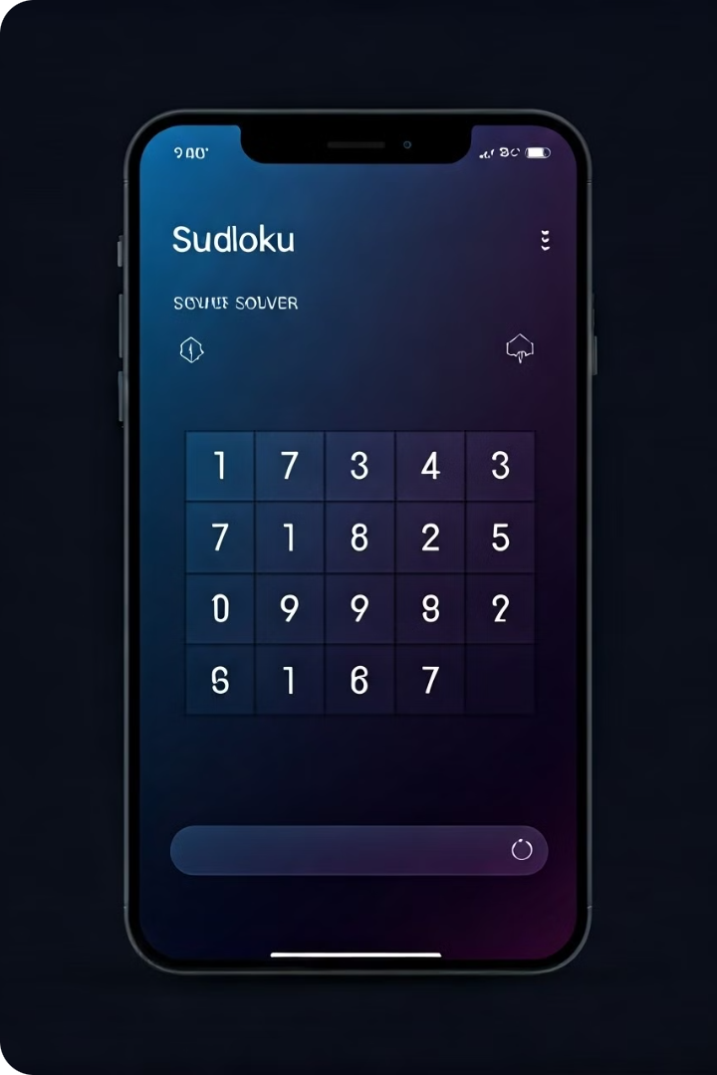

User Interface Design
Interactive Grid
The user interface will feature a fully interactive Sudoku grid, allowing users to input numbers, erase mistakes, and watch the solving process in real-time.
Customizable Themes
Users will be able to choose from a variety of visually appealing themes, allowing them to personalize the look and feel of the application to their preferences.
Progress Tracking
The user interface will provide clear visual indicators of the puzzle's progress, including the number of cells solved and the time elapsed, to help users stay engaged and motivated.
Intuitive Controls
The application will feature a straightforward and intuitive control scheme, making it easy for users of all skill levels to navigate and use the solver visualizer effectively.

Slide 6





Real-time Feedback and Hints
Hints
Validation
Time Tracking
Achievements
The visualizer will provide contextual hints to guide users, highlighting potential next moves and suggesting logical strategies to solve the puzzle.
The application will continuously validate the user's input, providing immediate feedback on any mistakes or invalid entries to help them stay on track.
The visualizer will include a timer to help users monitor their progress and challenge themselves to solve puzzles within a specified timeframe.
Users will be able to earn achievements and unlock rewards for completing puzzles, solving them efficiently, or mastering various solving techniques.

Slide 7
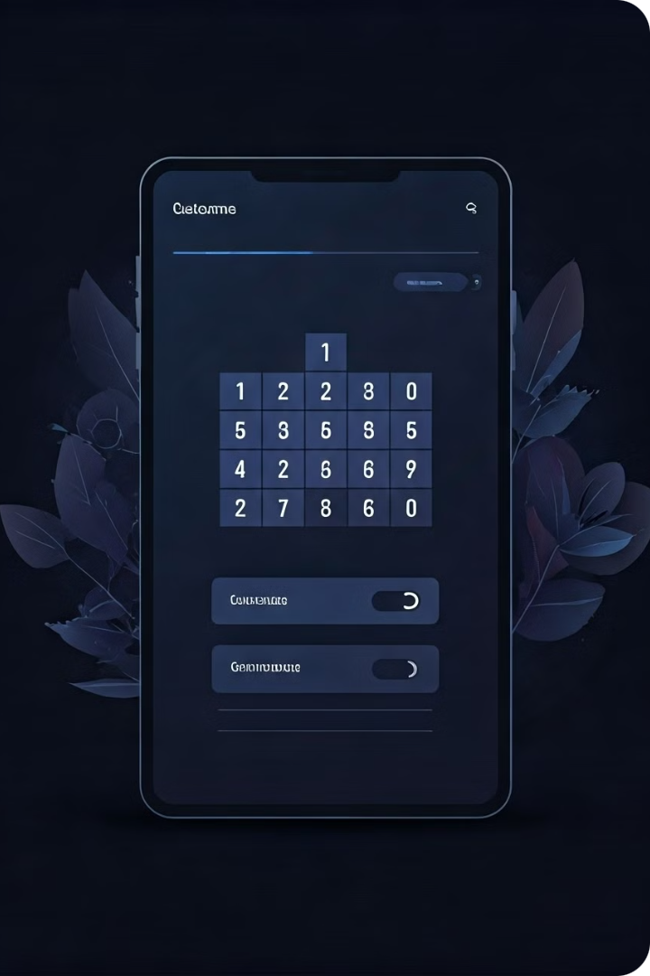



Customization Options
Difficulty Levels
Users will be able to select from a range of difficulty levels, allowing them to tailor the challenge to their skill level and progress through the game at their own pace.
Puzzle Types
The visualizer will offer a variety of puzzle types, including classic Sudoku, Samurai Sudoku, and other Sudoku variants, catering to the diverse preferences of users.
Solving Techniques
Users will have the ability to choose their preferred solving algorithm, whether it's brute force, logical reasoning, or constraint propagation, and observe the differences in the solving process.

Slide 8

Conclusion and Future Enhancements
The Sudoku Solver Visualizer is a powerful tool that not only solves complex puzzles but also provides an engaging and educational experience for users. As the application continues to evolve, we plan to introduce new features and enhancements, such as multiplayer modes, adaptive difficulty settings, and integration with social platforms to foster a thriving Sudoku community.
By combining cutting-edge visualization techniques, intuitive user interfaces, and a deep understanding of Sudoku solving algorithms, this visualizer aims to redefine the way people interact with and master the captivating game of Sudoku. Stay tuned for more exciting updates and features in the future!

